Slide 1
Quality Control

Slide 2
Phases of Quality Assurance
Inspection and
corrective
action during
production
Inspection of lots
before/after
production
Quality built
into the
process
Acceptance
sampling
Process
control
Continuous
improvement
The least
progressive
The most
progressive

Slide 3
Inspection
Inputs
Transformation
Outputs
Acceptance
Sampling
(inspection before
production)
Process
Control
(inspection
During
Production)
Acceptance
Sampling
(inspection after
Production)

Slide 4
How much to inspect and how often
Low cost, high volume items require little inspection and vice versa.
The amount of inspection depends on cost of inspection and the expected cost of passing the defective items.
With a high proportion of human involvement requires more inspection effort than mechanical operations.
The frequency of inspection depends on the rate at which a process may go out of control

Slide 5
Inspection Costs
Cost
Total Cost
Cost of inspection
Cost of passing
defectives
Optimal
Amount of Inspection

Slide 6
Where to Inspect in the Process
Raw materials and purchased parts
Finished products
Before a costly operation
Before an irreversible process
Before a covering process

Slide 7
Examples of Inspection Points

Slide 8
Control Chart
Control Chart
Purpose: to monitor process output to see if it is random
A time ordered plot representative sample statistics obtained from an on going process (e.g. sample means)
Upper and lower control limits define the range of acceptable variation

Slide 9
Control Chart
Abnormal variation due to assignable sources
Out of control
UCL
Mean
Normal variation due to chance
LCL
Abnormal variation due to assignable sources
0
1
2
3
4
5
6
7
8
9
10
11
12
13
14
15
Sample number

Slide 10
Statistical Process Control
The essence of statistical process control is to assure that the output of a process is random so that future output will be random.

Slide 11
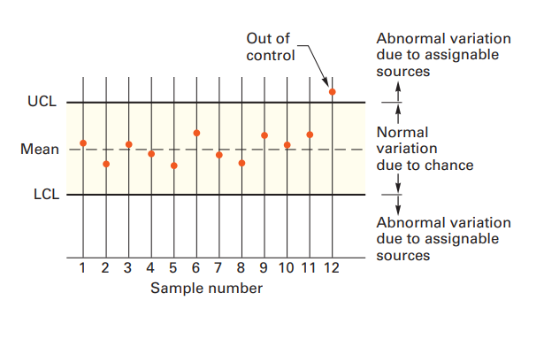
Statistical Process Control
Variations and Control
Random variation: Natural variations in the output of a process, created by countless minor factors
Assignable variation: A variation whose source can be identified

Slide 12
Normal Distribution
σ = Standard deviation
−3σ
−2σ
+2σ
+3σ
Mean
95.44%
99.74%

Slide 13
Control Limits
Sampling distribution
Process distribution
Mean
Lower control limit
Upper control limit

Slide 14
SPC Errors
Type I error
Concluding a process is not in control when it actually is.
Type II error
Concluding a process is in control when it is not.

Slide 15
Type I and Type II Errors
 | In control | Out of control
In control | No Error | Type I error (producers risk)
Out of control | Type II Error (consumers risk) | No error

Slide 16
Control Charts for Variables
Variables generate data that are measured.
Mean control charts
Used to monitor the central tendency of a process.
X bar charts
Range control charts
Used to monitor the process dispersion
R charts

Slide 17
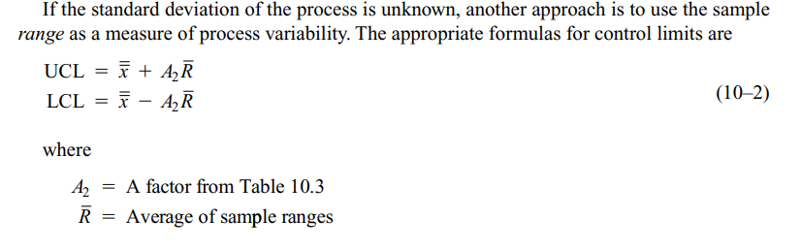
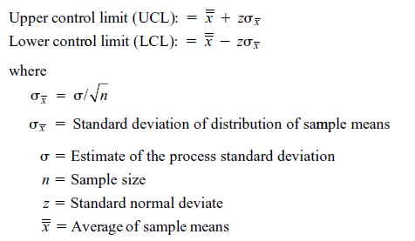
Mean Chart

Slide 18
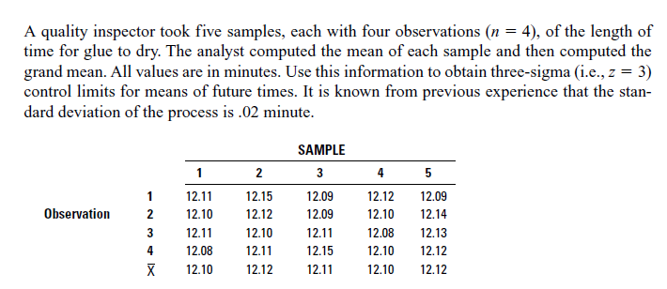
Example

Slide 19
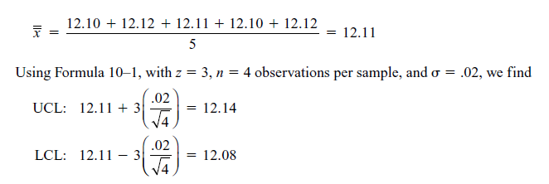
Solution

Slide 20
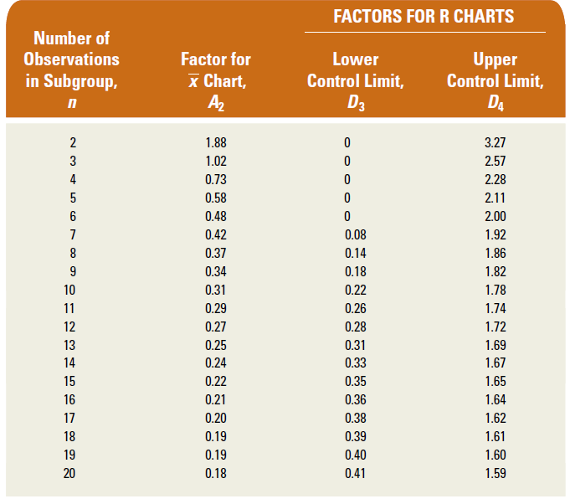

Slide 21
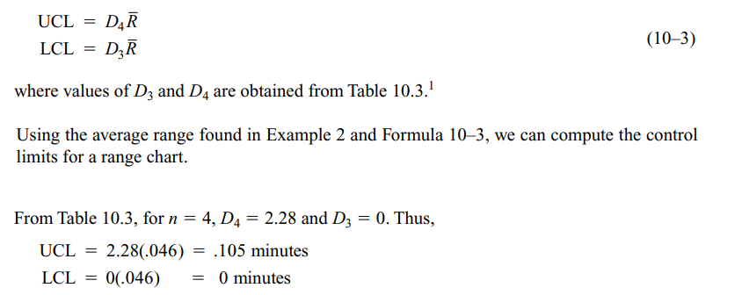
Range Charts

Slide 22
Control Chart for Attributes
p-Chart - Control chart used to monitor the proportion of defectives in a process
c-Chart - Control chart used to monitor the number of defects per unit
Attributes generate data that are counted.

Slide 23
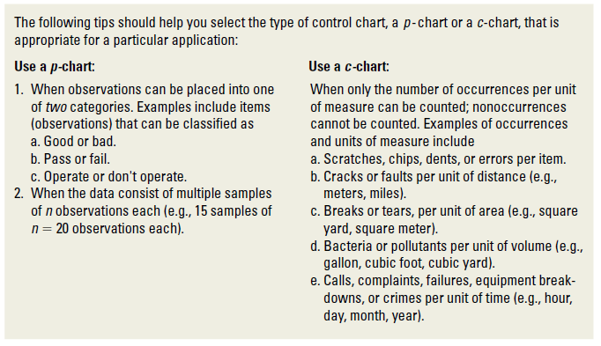

Slide 24
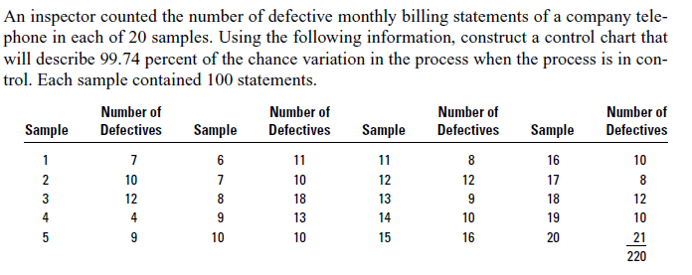
P-chart

Slide 25
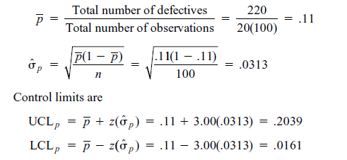

Slide 26
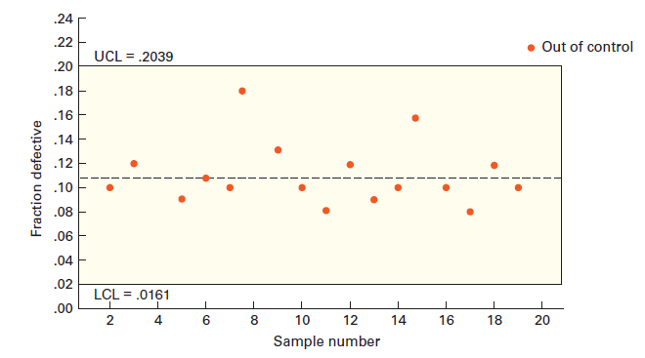

Slide 27
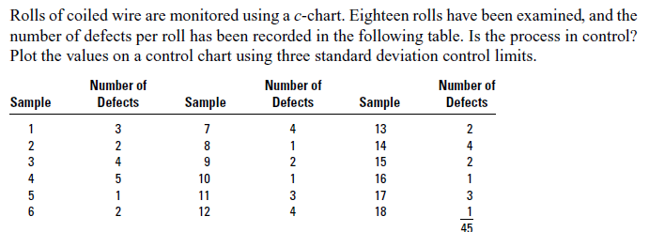
C-chart

Slide 28
